Slide 1
CSC312
Automata Theory
Lecture # 4
Recursive Definations
Regular Expressions
Ch # 4 by Cohen

Slide 2
Recursive Language Definition
A recursive definition is characteristically a three-step process:
1. First, we specify some basic objects in the set. The number of basic objects specified must be finite.
2. Second, we give a finite number of rules for constructing more objects in the set from the ones we already know.
3. Third, we declare that no objects except those constructed in this way are allowed in the set.

Slide 3
Example:
Example: Consider the set P-EVEN, which is the set of positive even numbers.
We can define the set P-EVEN in several different ways:
• We can define P-EVEN to be the set of all positive integers that are evenly divisible by 2.
• P-EVEN is the set of all 2n, where n = 1, 2, . . ..
P-EVEN is defined by these three rules:
  Rule 1 2 is in P-EVEN.
  Rule 2 If x is in P-EVEN, then so is x + 2.
  Rule 3 The only elements in the set P-EVEN are those that can be produced from the two rules above.

Slide 4
Example:
Example: Let PALINDROME be the set of all strings over the alphabet = {a, b} that are the same spelled forward as backwards; i.e., PALINDROME = {w : w = reverse(w)} = {, a, b, aa, bb, aaa, aba, bab, bbb, aaaa, abba, . . .}.

Slide 5
Recursive Definition of PALINDROME
A recursive definition for PALINDROME is as follows:
Rule 1 , a, and b are in PALINDROME.
Rule 2 If w 2 PALINDROME, then so are awa and bwb.
Rule 3 No other string is in PALINDROME unless it can be produced by rules 1 and 2.

Slide 6
Arithmetic Expressions(AE)
We recursively define AE using the following rules:
What are the rules?

Slide 7
Recursive Definition of AE
Rule 1: Any number (positive, negative, or zero) is in AE.
Rule 2: If x is in AE, then so are
  (i) (x)
  (ii) -x (provided that x does not already start with a minus sign)
Rule 3: If x and y are in AE, then so are
  (i) x + y (if the first symbol in y is not + or -)
  (ii) x - y (if the first symbol in y is not + or -)
  (iii) x * y
  (iv) x / y
  (v) x ** y (our notation for exponentiation)
Theory Of Automata

Slide 8
RE
The above definition is the most natural, because it is the method we use to recognize valid arithmetic expressions in real life.
For instance, we wish to determine if the following expression is
valid:
(2 + 4) * (7 * (9 - 3)/4)/4 * (2 + 8) - 1
We do not really scan over the string, looking for forbidden substrings or count the parentheses.
We actually imagine the expression in our mind broken down into
components:
  Is (2 + 4) OK? Yes
  Is (9 - 3) OK? Yes
Theory Of Automata

Slide 9
Arithmetic Expression AE
Obviously, the following expressions are not valid:
(3 + 5) + 6) 2(/8 + 9) (3 + (4-)8)
The first contains unbalanced parentheses; the second contains the forbidden substring /; the third contains the forbidden substring -).
Are there more rules? The substrings // and */ are also forbidden.
Are there still more?
The most natural way of defining a valid AE is by using a recursive definition, rather than a long list of forbidden substrings.
Theory Of Automata

Slide 10
Regular Expressions (REs)
Any language-defining symbols generated according to some rule are called regular expressions OR a regular expression is a pattern describing a certain amount of text OR
A regular expression represents a "pattern“; strings that match the pattern are in the language, strings that do not match the pattern are not in the language.
Regular expressions describe regular languages.

Slide 11
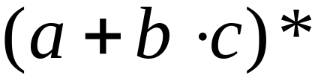
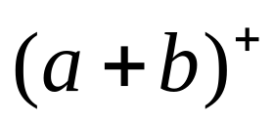
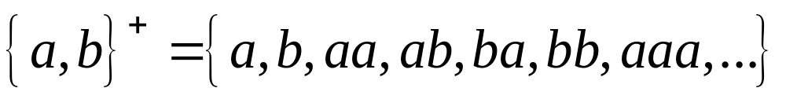
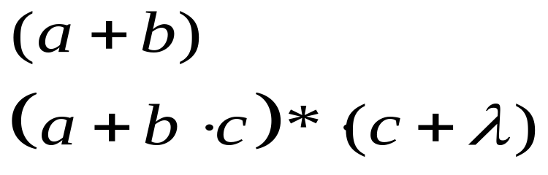
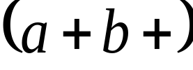
Regular Expressions
Example:
describes the language
Example:
describes the language
Example:
Not a regular expression:

Slide 12
REs
Here instead of applying Kleene Star Operation (KSO) over some set S, we shall straight away apply KSO on some alphabet say “a” and write it as “a*” which means
a* = λ, a, aa, aaa, …….
And Kleene plus closure is
a⁺ = a, aa, aaa, …….
Where a⁺ = aa*
a* = λ + a⁺

Slide 13
Operators allowed in REs
Every RE can contains concatenation “dot” operator, + i.e. logical operator “or”, Kleene Star Closure, Kleene Plus Closure and parenthesis only.
Precedence of Operators:
The Kleene Star (or Kleene Plus) operator has highest precedence.
Next come the precedence of concatenation or “dot” operator.
The union or + operator has the lowest priority.

Slide 14




Primitive REs
Primitive regular expressions:
Thus, if |Σ| = n, then there are n+2 primitive regular expressions defined over Σ .
Given regular expressions and
Are regular expressions

Slide 15
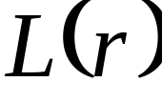

Languages of Regular Expressions
: language of regular expression
Example:
The languages defined by the primitive regular expressions are:
(i) The primitive regular expression φ denotes the language {}. There are no strings in this language.
(ii) The primitive regular expression λ denotes the language {λ}. The only string in this language is the empty string or the string with no letters.
(iii) For each x ∈ Σ , the primitive regular expression x denotes the language {x} i.e. the only string in the language is the string "x".

Slide 16
Note: The language φ is the language with no words and for REs, the φ is the regular expression for the null language.
If r and φ are REs then
r + φ = r
and φr = φ

Slide 17
Languages of Regular Expressions
Example: Consider the alphabet Σ={a}
The language of all words containing even number of a’s can be defined by the following RE (aa)*
Example: Language of all words containing only odd no. of a’s can be defined by the following RE
1. (aaa)* 2. a(aa)*+λ 3. a+(aa)* 4. a⁺a*
5. a+(aa)*a correct but inefficient due to repetition
6. (aa)*a or a(aa)* correct

Slide 18
Languages of Regular Expressions
Example: The language of all words having all possible combinations of a’s followed by one b can be described by the following RE.
1. a+b 2. a*+b 3. a*b 4. (λ+a⁺)b 5. a⁺b+b
Example: The language of all words in which all a’s (if any) comes before all the b’s (if any) can be defined the following RE
(ab)* 2. a*b*
3. a+b+a⁺b⁺+λ 4. b+a⁺b*+λ both are inefficient

Slide 19
Example:The language of all words of a’s & b’s that have atleast two letters, that begin & end with a’s & that have nothing but b’s inside (if any thing at all) can be defined by following RE.
Σ = {a, b}
(aba)* 2. ab*a⁺ 3. ab⁺a 4. a⁺b*a⁺
all above are incorrect
5. ab*a

Slide 20
Example: Consider the alphabet Σ={a,b,c}. The language of all words that begins with either a or c, followed be any no. of b’s can be defined by following RE.
(a+c)b* = ab* + cb*
Example: The language of all words that ends with letter b can be defined by the following RE
(a+b)*b

Slide 21
Example: The language of all words that have at least 1 a in them somewhere can be defined be by RE
(a+b)*a(a+b)*
Example:The language of all words that have at least 2 a’s in them somewhere.
(a+b)*a(a+b)*a(a+b)* OR
b*ab*a(a+b)* OR
b*a(a+b)*ab* OR
(a+b)*ab*ab*

Slide 22
Example: The language of all words that have exactly 2 a’s in them somewhere can be defined by RE
b*ab*ab*
Example: The language of all words that have at most one a in them somewhere can be defined by RE
b*(a+λ)b* OR
b*ab* + b*

Slide 23
Example: The language of all words having at least one a and one b, may be expressed by the following RE
(a+b)*a(a+b)*b(a+b)* + (a+b)*b(a+b)*a(a+b)*
Example: The language of all words starting with a and ending in b or starting with b and ending in a, may be expressed by the following RE
a(a+b)*b + b(a+b)*a

Slide 24
Example: The language of all strings that at some point contain a double letter, may be expressed by the following RE
(a + b)*(aa + bb)(a + b)*
Example: The language of all strings that do not contain a double letter, may be expressed by the following RE
(λ + b) (ab)*(λ + a)

Slide 25


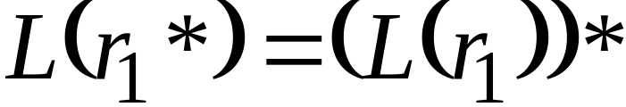

Definition
For regular expressions and

Slide 26

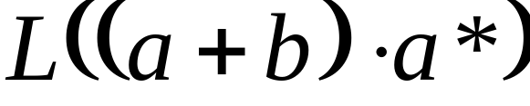


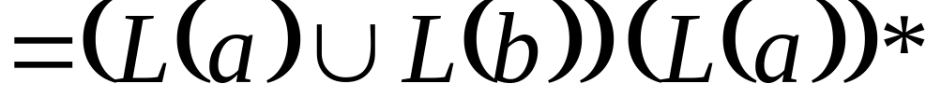
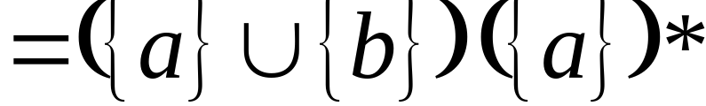
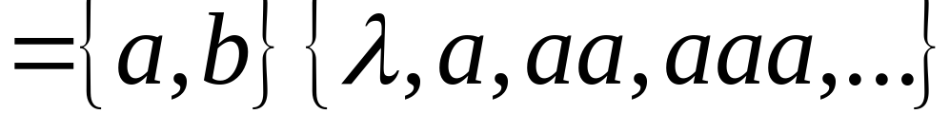
Example
Regular expression:

Slide 27



Example
Regular expression
Regular expression

Slide 28


Example
= { all strings with at least
two consecutive 0 }
= { all strings without
two consecutive 0 }

